Slide 1
the

Slide 2
There once was a can called Ali, who was picked up and put in a trolley.

Slide 3
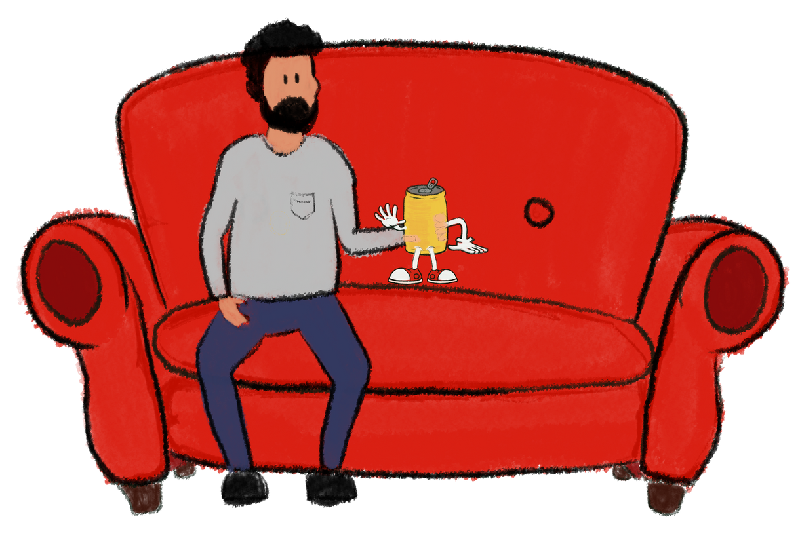
Ali met Michael. Michael was thirsty, he drank Ali on the first day!
He gulped him down in one swallow, but the worst news was still to follow.

Slide 4
You see, Michael didn't know how to recycle!
And so Ali went in the wrong bin and that's where his journey begins.

Slide 5
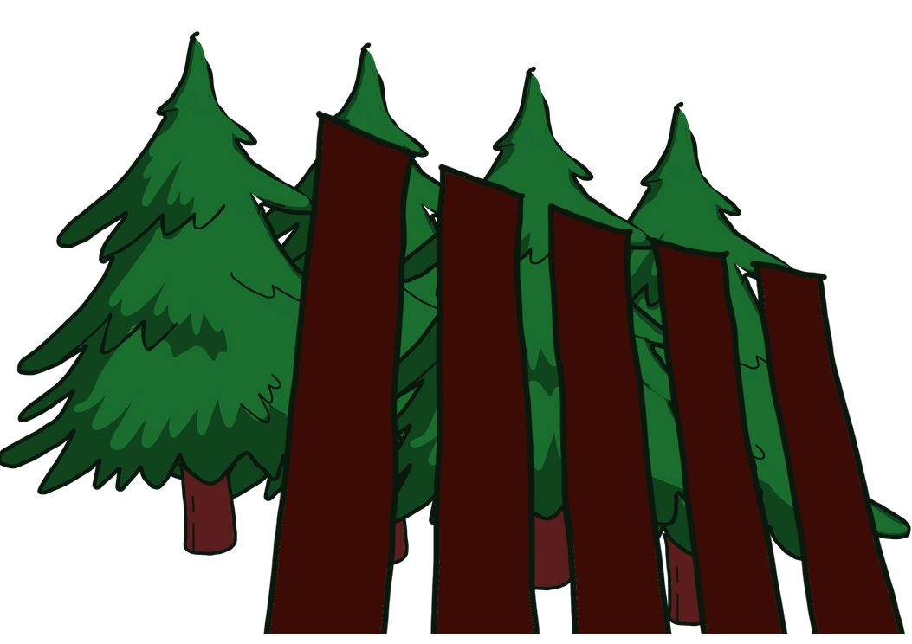
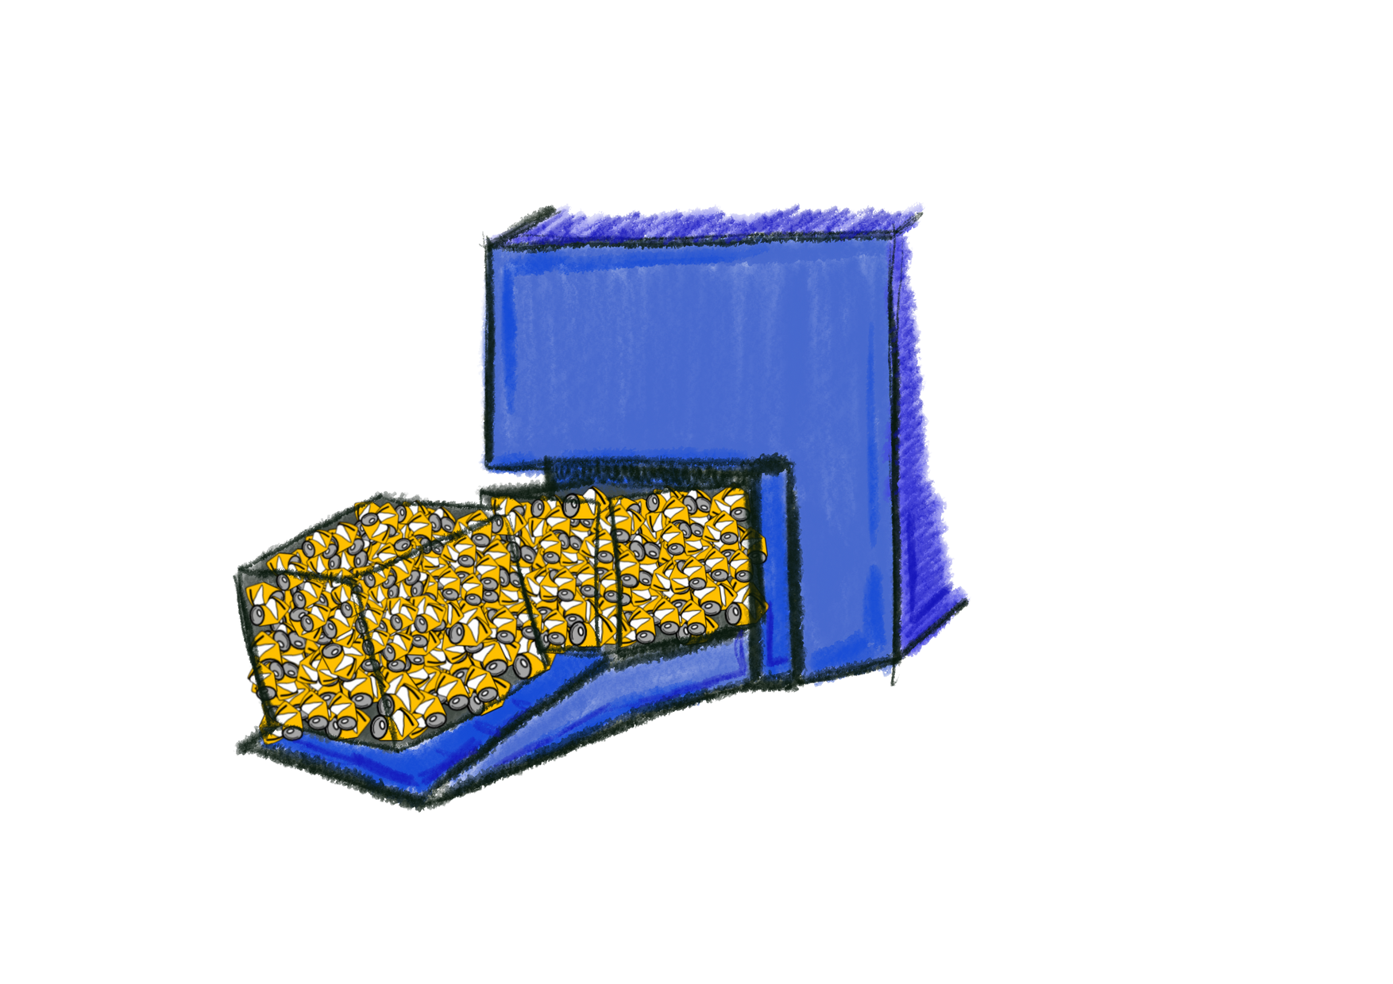
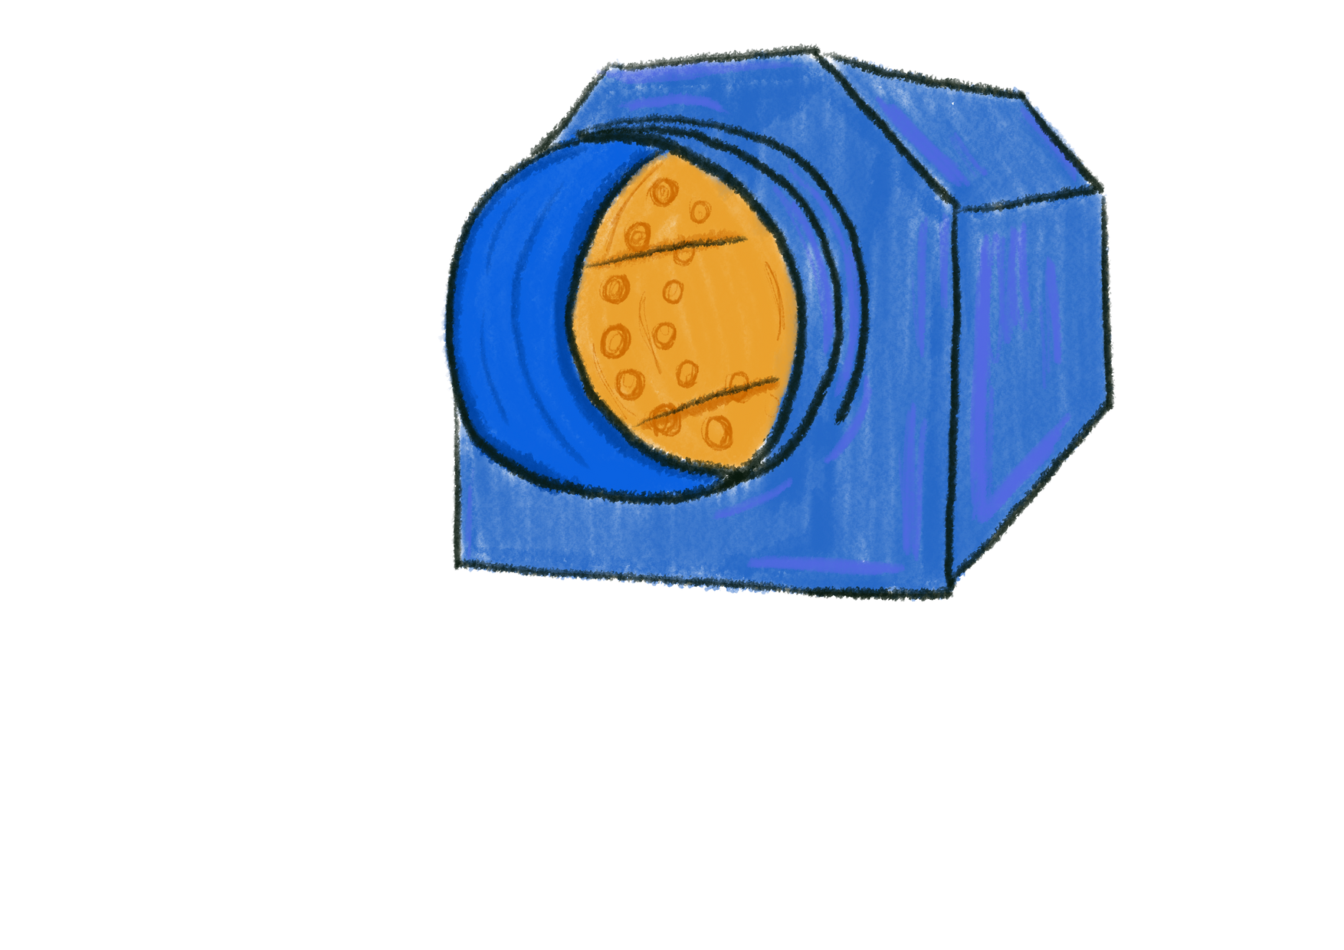
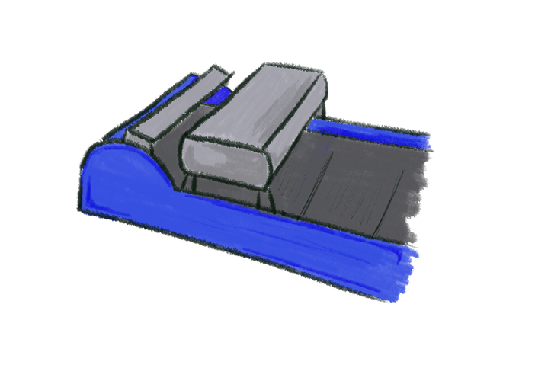
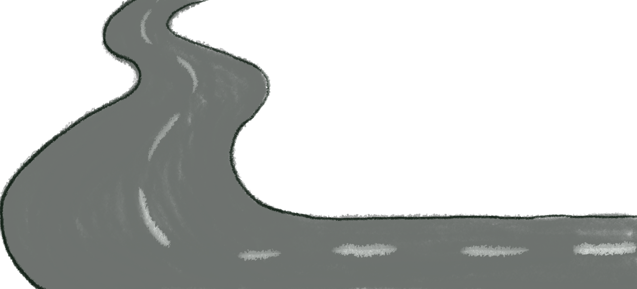
Off Ali went on an adventure but where would he go, do you know?

Slide 6
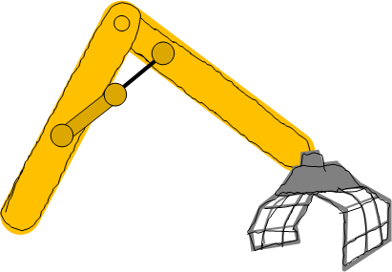
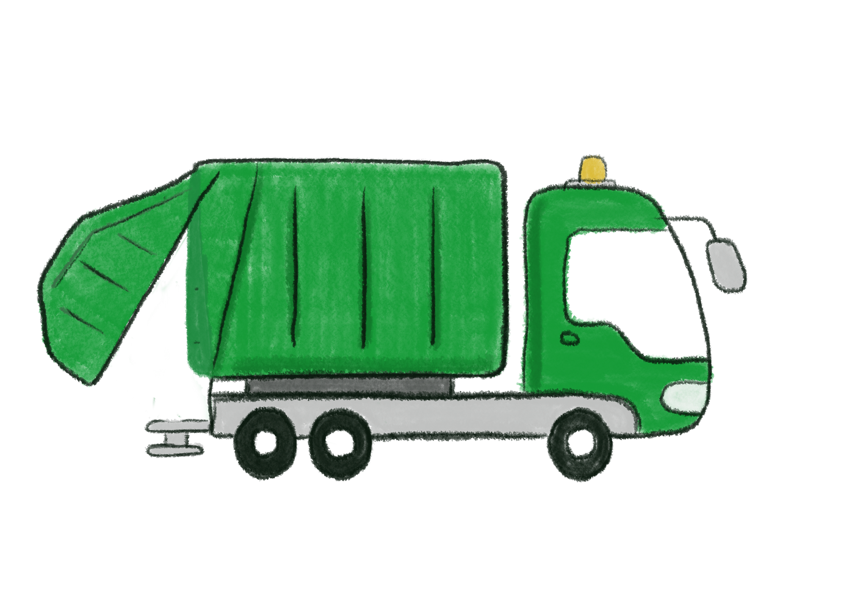
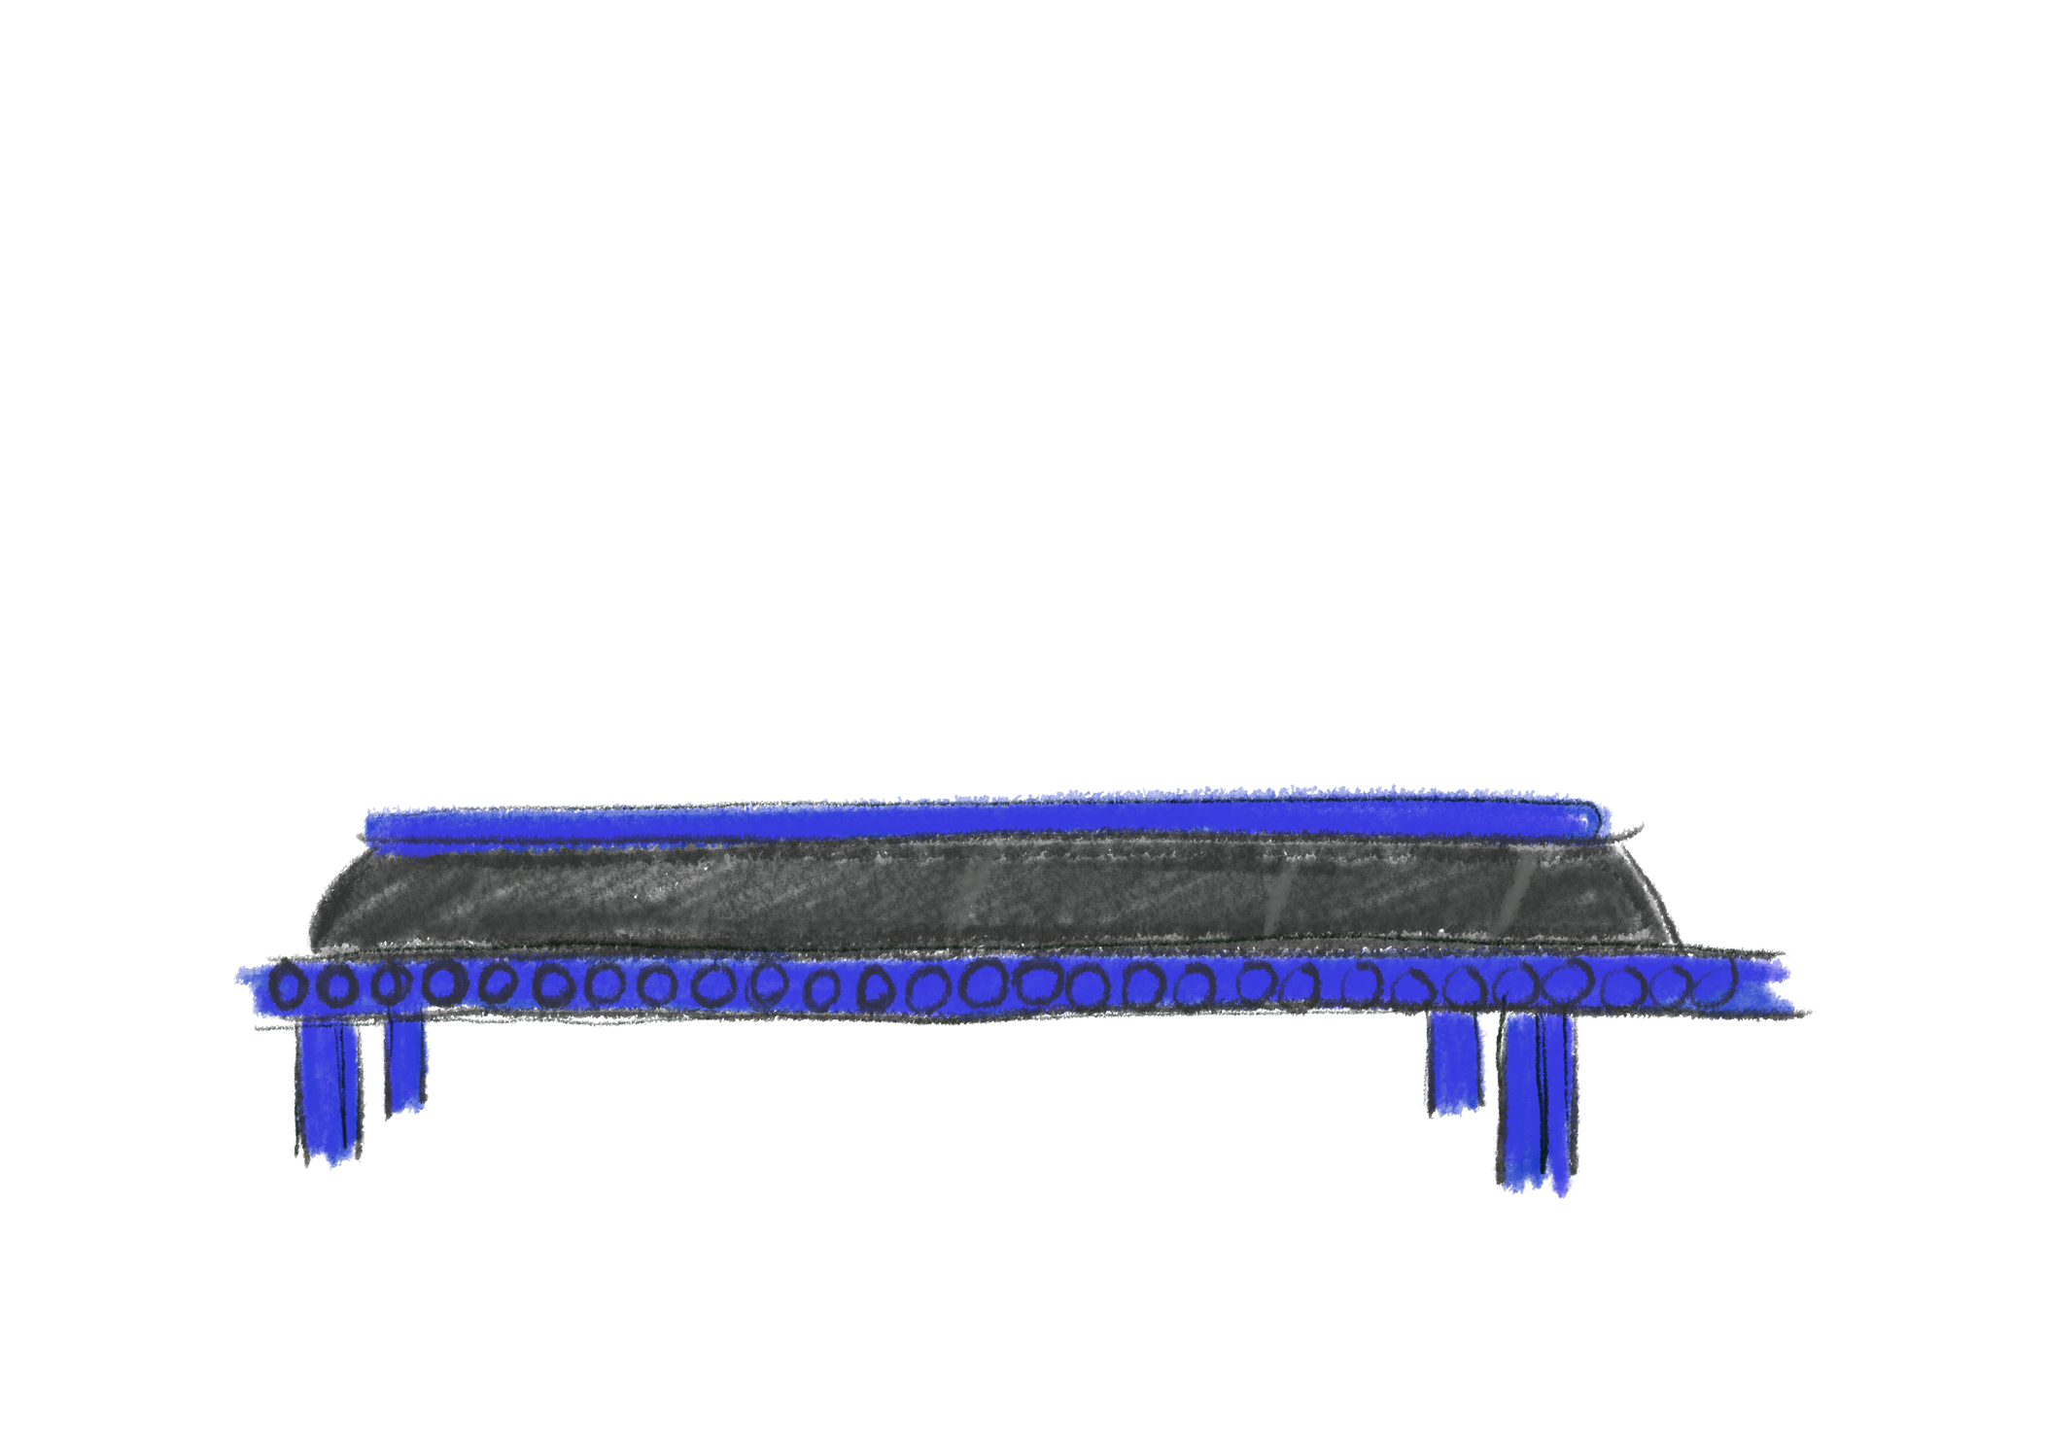
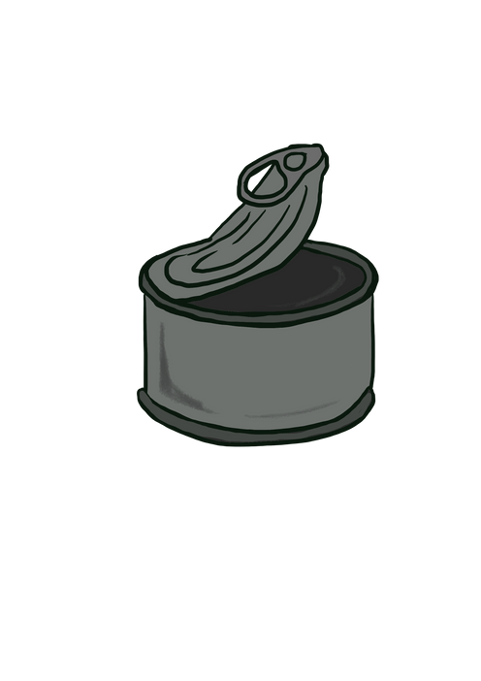
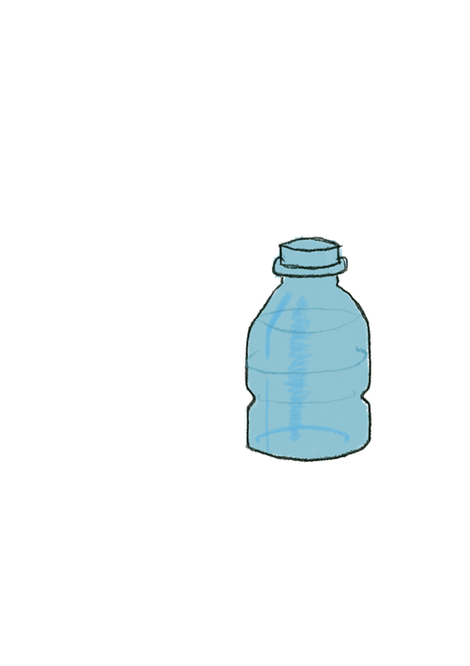
What's this thought Ali? A big arm has just grabbed me. But where will he go do you know?

Slide 7
Hello said a voice, I'm Mandy and this is Sandy, and together we are team Handy.
Don't be frightened said Mandy, you are about to be enlightened, you won't go to the landfill, you're in for a real thrill.
But where will he go do you know?

Slide 8
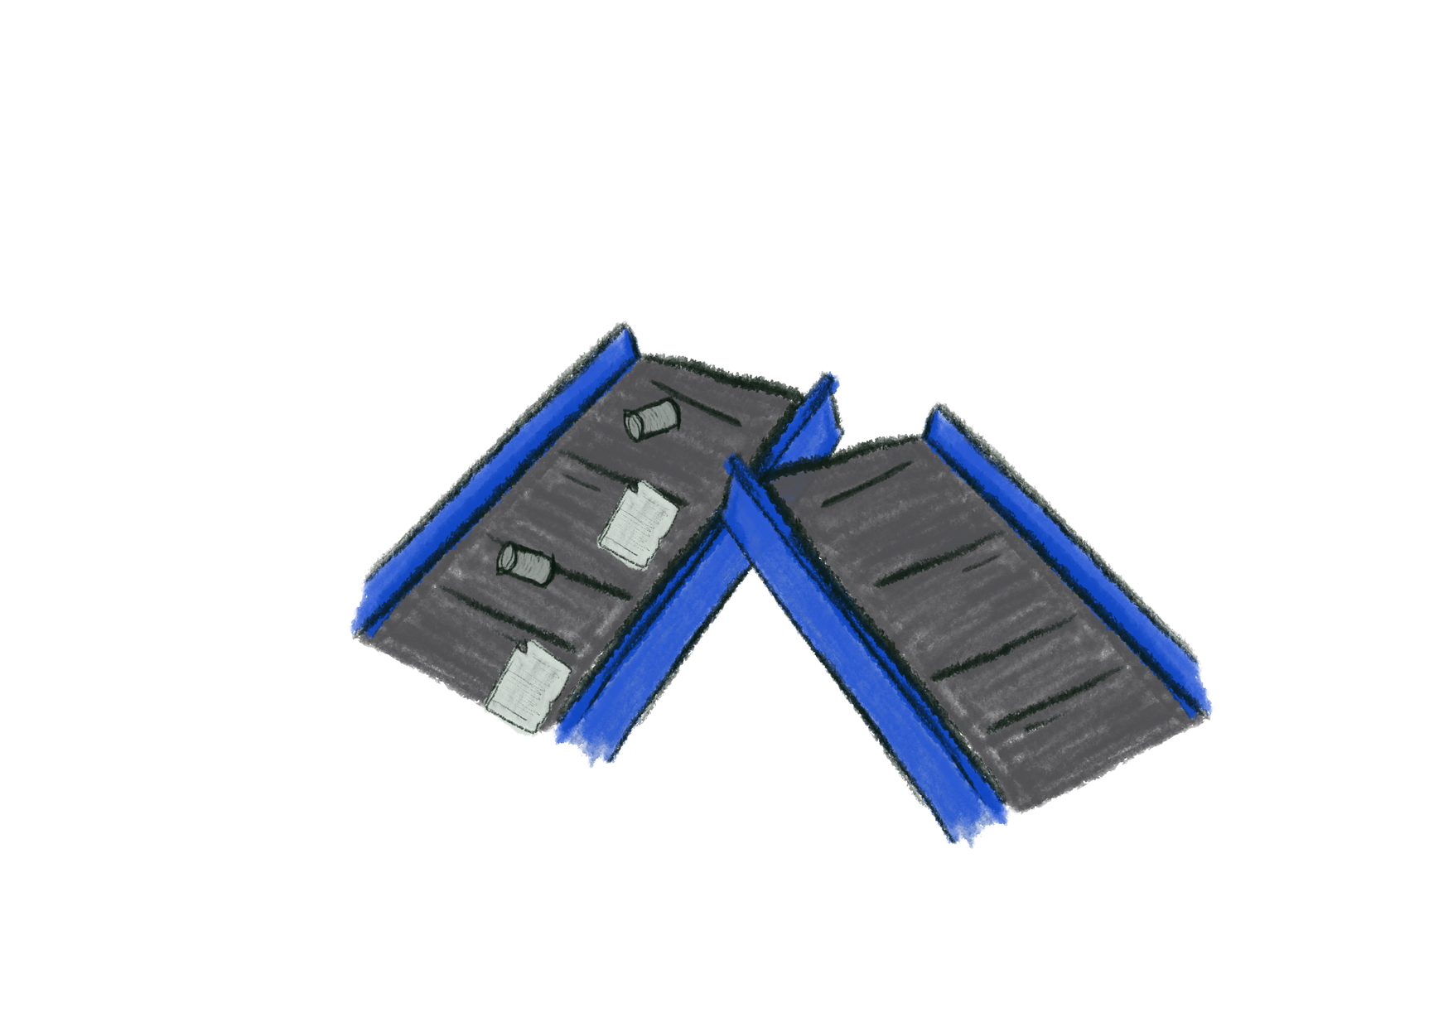
The first stop was a large trommel, round and round it went but where would the waste be sent?
It went on a rollercoaster ride where the waste would divide.

Slide 9
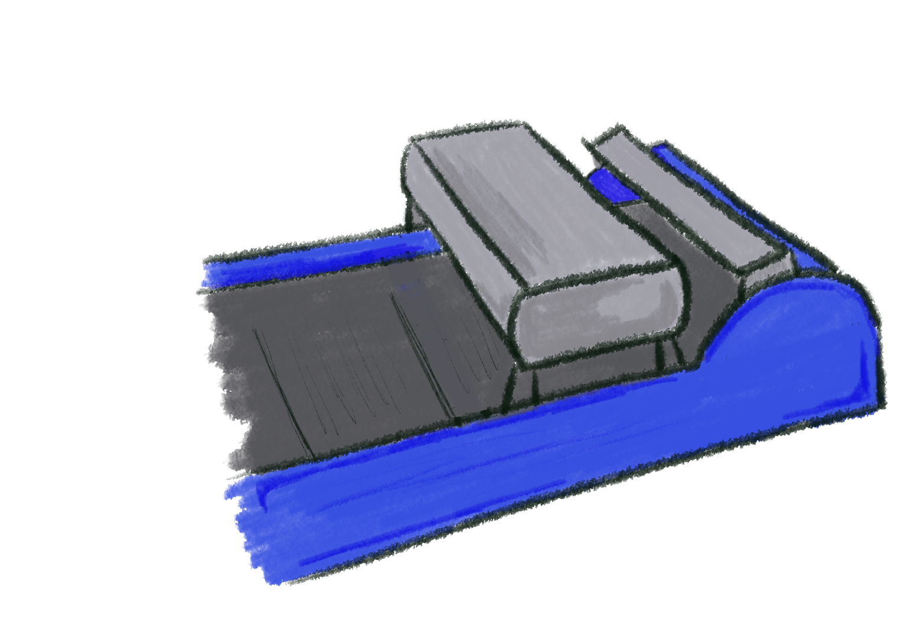
Optical sorters saved the plastic, isn't that fantastic, but where will it go, do you know?

Slide 10
Next was the metals, pots, pans and old tin cans.
They were recovered by the magnet, great we are saving the planet.
But where will it go, do you know?

Slide 11
What is this machine? There are more cans than Ali has ever seen.
It's an eddy current, it uses electricity to recover aluminium so simplistically.
Ali has found his friends, is this where his journey ends?

Slide 12
Don't worry said his friends it's not where it ends, now that the waste is all divided our families are united.
Metal, plastic, paper, there is no waste here. Even the fluff goes on to make better stuff.

Slide 13
The fluff thought Ali, how can that be?
The fluff is a fuel just like gas, coal or oil. It helps us heat water and brings it to a boil.

Slide 14
We mix it and blitz it to make our top-secret fuel potion.
We treat it and heat it to make our own gas, which is burned to make steam just like your kettle.
The steam turns the turbine and electricity is generated, it goes to the grid to power 25, 000 homes, it's estimated.

Slide 15
Any dirty gas emissions are cleaned, scrubbed and filtered.
They go back out safely through our very large chimney.

Slide 16
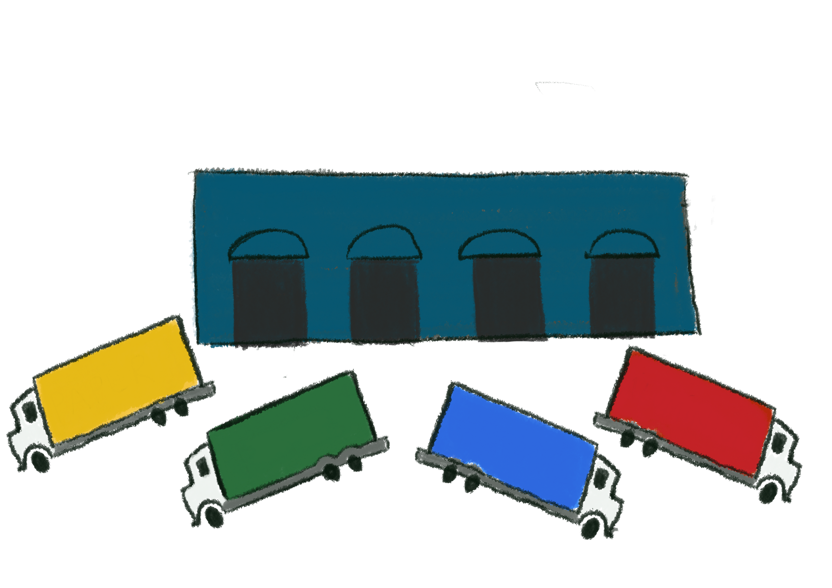
So next time you put something in your bin, be sure to remember the story of Ali, and everything it took to reunite him with his family, to be recycled - finally.
Your town is landfill-free let's use the right bins and keep it that way.
The end.

